Slide 1
PROJECT LIFECYCLE MANAGEMENT
GROUP4
Manav, Christian, Rachit, Alan
Tandhy, Yuvaraj and Vipul

Slide 2
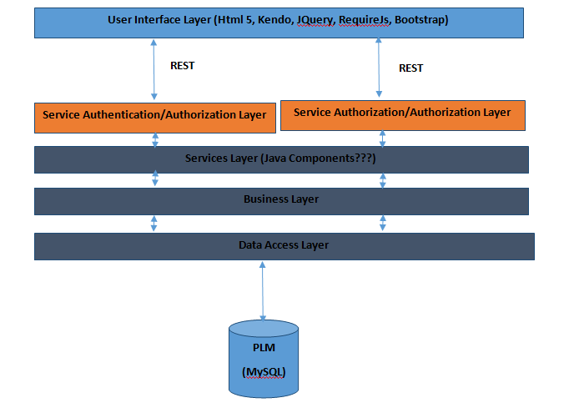
Software Design Architecture

Slide 3
Software Design Architecture
User Interface is Model View ViewModel(MVVM) pattern.
Kendo framework is jquery client library that provides the MVVM pattern.
MVVM facilitates a clear separation of the development of the GUI from the back end.

Slide 4
Services Design Architecture
In Service Authentication, username and password are sent to the service and validated against the database.
In Service Authorization, service access is granted or denied based on requested feature and user role.
Service, Business and Data Access layer exposes all business functionality in the form of services.

Slide 5
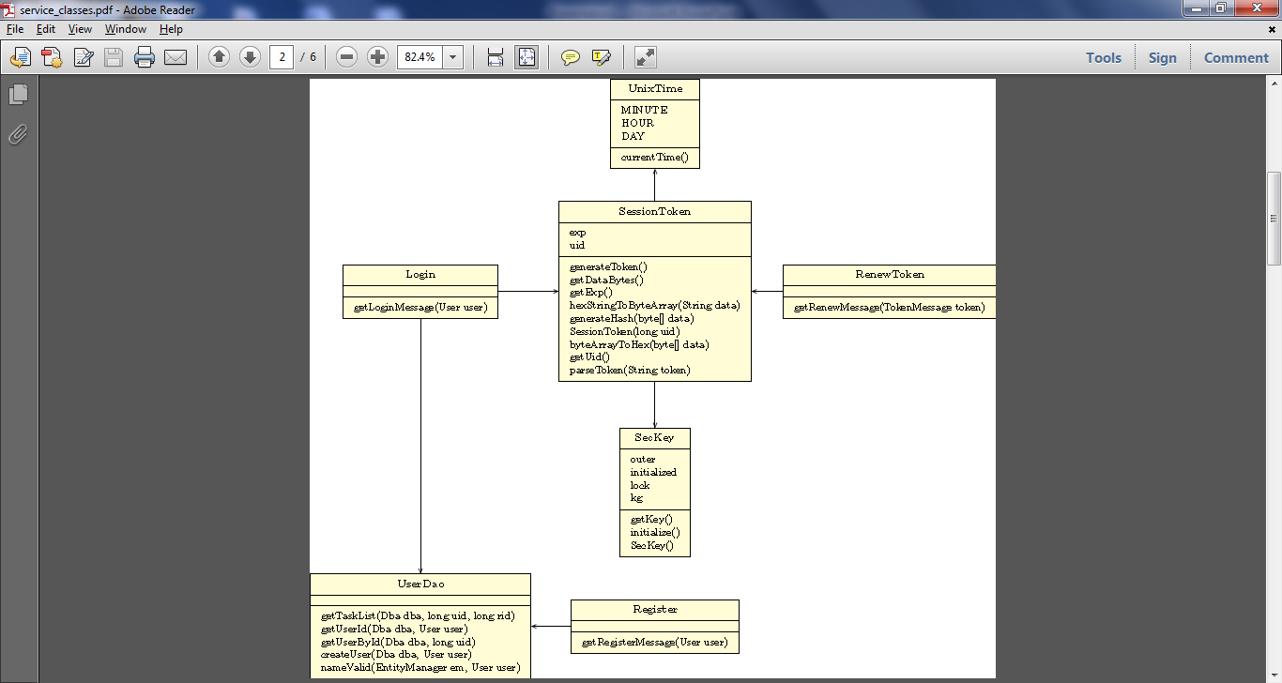

Slide 6
User Stories Implemented
Feature to register users to the system
Log-in ID and password fields on the main page
Only registered users can log in and access will be restricted based on user roles
Configuration to assign roles to members of the team
Dashboard view to see the list of tasks assigned to a member

Slide 7
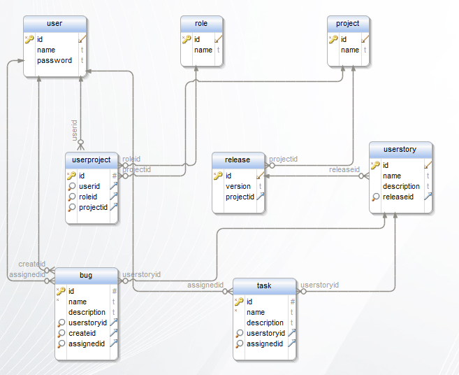
Database Schema

Slide 8
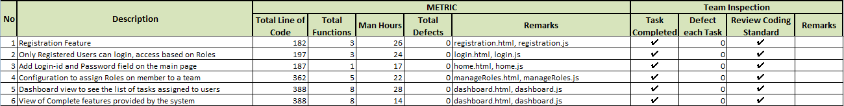
Iteration1 Metrics

Slide 9
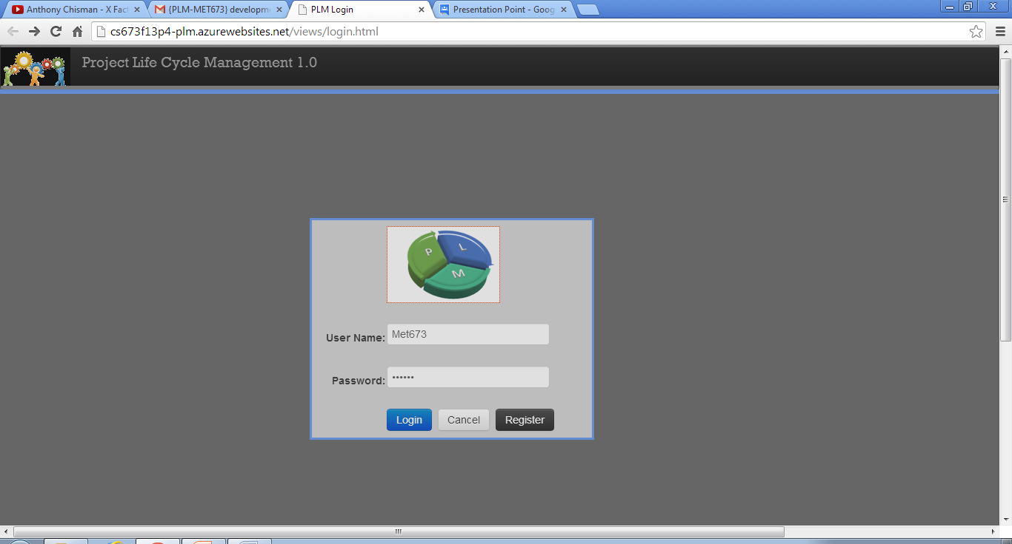
Graphical User Interface

Slide 10
Future Scope
For the next iteration we would be implementing the following user stories:
Ability to define a release and create user stories under a release.
Project List (Multi-Project View)
Create and assign tasks to a project member
Features would be added as needed and the related services will be worked upon.

Slide 11
THANK YOU

